Slide 1
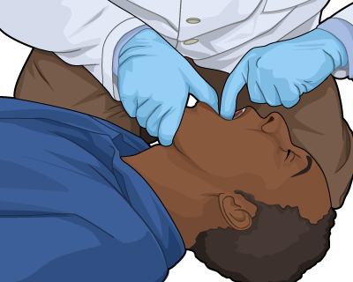
Unconscious Choking

Slide 2
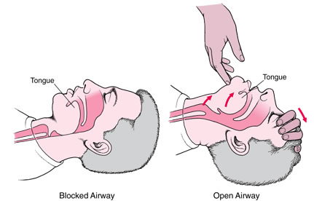
Unconscious Choking
Introduction
You begin your victim check and find that the victim is not breathing. When you attempt the two rescue breaths, the air does not go in.
What are you going to do?
Re-adjust head tilt, chin lift & give 2 rescue breaths.

Slide 3
Unconscious Choking
Objectives:
Students will be able to:
  Identify the steps involved in the resuscitation of an unconscious choking victim
  Perform adult, child & infant resuscitation on an unconscious choking victim

Slide 4
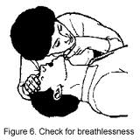
Unconscious Choking
You have checked the scene for safety and determined that the victim is unconscious. EMS has been contacted.
  What do you do?
Open airway & look-listen-feel for 10 seconds.

Slide 5
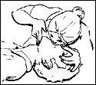
Unconscious Choking
Victim is not breathing.
  What do you do?
Give 2 rescue breaths.

Slide 6
Unconscious Choking
When attempting rescue breaths, air does not go in.
  What are the possible causes?
Airway is not open or airway is obstructed.

Slide 7
Unconscious Choking
When attempting rescue breaths, air does not go in.
  What do you do?
Re-adjust the head tilt, chin lift & give 2 rescue breaths.

Slide 8
Unconscious Choking
The airway is still blocked.
  A safe presumption would be … ?
Airway is obstructed.

Slide 9
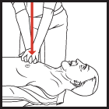
Unconscious Choking
The airway is still blocked.
What do you do?
Start a modified CPR technique. Perform 30 abdominal compressions similar to CPR.

Slide 10
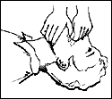
Unconscious Choking
Open mouth and
look for any foreign
objects. If no object
seen … do not stick
your fingers in
victim’s mouth.
Then…IF YOU SUCCESSFULLY REMOVE AN OBJECT

Slide 11
Unconscious Choking
Give 2 more rescue breaths to see if victim now has airway.
If no airway, give 30 more chest compressions
Check the mouth for an object and give 2 more rescue breaths.

Slide 12
Unconscious Choking
Open mouth and look for any foreign objects. If object is seen, use hooking motion with finger to pull the object out of the mouth.
Then…

Slide 13
Unconscious Choking
Give 2 more rescue breaths to see if victim now has airway.
If no airway, give 30 more chest compressions
Check the mouth for an object and give 2 more rescue breaths.

Slide 14
Unconscious Choking
Continue breaths, foreign object check, and compressions until
Object is removed
Breaths go in
Someone qualified can take over
Your victim regains consciousness

